Slide 1
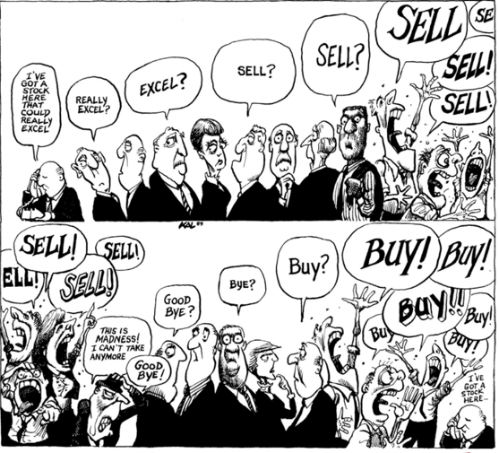
Cas Applied Data Science – October 7th 2021 Nasdaq composite price & macroeconomic variables
University of Bern
Sources: The economist
Notes:
The objective is to see if there is any impact from the selected macro variables on the monthly price return of the Nasdaq composite index
These include the semi strong efficient market hypothesis developed by Fama (1970) and the Arbitrage Pricing Theory (APT) developed by Ross (1976).
The semi strong hypothesis states that all publicly available information is already incorporated into current prices; that is the asset prices reflect all available public information. Indeed, the semi strong hypothesis is used to investigate the positive or negative relationship between stock return and macroeconomic variables since it postulates that economic factors are fully reflected in the price of stocks.

Slide 2
Project objectives & Data set description
Research objective:
The objective of this research is to examine the impacts of some macroeconomic factors on the stock market returns of the NASDAQ composite index
Two models are conducted in this study:
The Ordinary Least Squared (OLS) to test the relationship between the macro variables and the NASDAQ composite index
The Granger Causality test to examine the relation between individual explanatory variables and the NASDAQ composite index (bidirectional).
Abstract:
Macroeconomic variables affect the performance of the stock market. Investors consider macroeconomic variables when they value stocks. Interest rates, unemployment, inflation and GDP are very important among these macroeconomic variables which are often used to explain stocks price performance. Several studies have been conducted to determine the relationship between the macroeconomic variable and stock prices in the past.
We use 4 independent variables: US GDP, US CPI, US Interest rates, US Unemployment rates and one dependent variables: Nasdaq composite price performance
Sources: Fed Saint Louis & Nasdaq
Notes:
Investors are widely considering that macro variables are affecting stocks markets you even have a whole field of investing that focus on looking at macro variables and macro trends to invest it’s the global macro hedge funds. Lot of studies have been performed on the topic, but as far I know, not on the NASDAQ. Here we have looked at 4 macro variables, which will be our independent variables, the GDP, CPI, interest rate and unemployement rate. I will explain the variables as well as the nasdaq soon. In order to run our Analysis we have considered two models, the OLS ordinary Least Squared to test the relationship between the independent variables and dependent variable and the Granger causality test to examine the relation between individual variables and the Nasdaq so if the direction of one variable can explaine de direction of the other.

Slide 3
Data set description and methods
Date set description: The data set consists of 95 instances and 5 attributes
There are 4 independent variables:
-US GDP: We use GDP in percent change from preceding Period, quarterly, Seasonally Adjusted Annual Rate.
-US CPI (consumer price inflation): Growth Rate Same Period Previous Year, Monthly, Seasonally Adjusted.
-US Interest rates: Effective Federal Funds Rate, Percent, Monthly, Not Seasonally Adjusted.
-US Unemployment rate in Percent, Monthly, Seasonally Adjusted.
Dependent variable:
-Nasdaq composite index, which is a stock market index includes almost all stocks listed on the Nasdaq stock exchange. The index is heavily towards Information Technology / Communication sectors
Sources: Fed Saint Louis & Nasdaq
Simplified data flow
Fed Saint-Louis timeseries for independent variables
Loading the data into Jupyter (csv or api)
Test for stationarity then first / second difference
OLS and Granger causality test
Cleaning, merging & data analyses
Nasdaq website time series for dependent variable
Notes:
As I said we have 4 independenant variables. With the exception of GDP all on a monthly basis and seasonality adjusted for all of them but the US interest rates, as for the unemployment, CPI and GDP you have element of seasonality in there which matter for time serie analysis as for exemple unemployment rate might tend to rise when the university year is finished and new people enter the workforce or CPI also can follow customer pattern purchase with for example thankgiving in the US. While interest rates well, the FED, the US central bank is well not suposed to set up its monetary policy so the interest rate based on weather forecast or whatever.
A word on the NASDAQ composite index, well it’s a famous index with the S&P 500 and Dow Jones, it’s listed on the Nasdaq stock exchange, long story short it was launched in 1971 with a value of 100 and now it worth more than 14000 points. It captures the performance of more than 3000 stocks with a huge tilt towards technology stocks such as the famous Amazon, Facebook, and so on.
Here you can see our simplified data flow we took the data publicly available for the FED of Saint-louis and the Nasdaq. It’sl loaded into jupyter as csv then we cleaned and merged the data. For time series analysis you can apply couple of filters that you can and must do for some of them: - Detrending: non-stationarity and seasonality.
- Autocorrelation: Noise and signals can be autocorrelated, they might have some memories. Degree to which time series value sin period (t) are related to time series values in periods (t+1, t+2..). AR to detect non randomness in data. Treating the correlation by shifting the time series in time and the correlation of the timeserie with itself. If you have a high correlation then you have periodicity.
Outliers
Low pass filters: Smoothing (moving average, exponential) getting rid of the noise
Extract the signal and not noise (white noise).
Once you get rid of the signal (trends, periodicity and autocorrelation) you are left with white noise whihc is a random process whose samples are a sequency of serially uncorrelated random ariables with zero mean and finite variable.
In the interest of times we have just put in the appendix and the workbook the residual analysis with the AR, Homoescadisity and Normality tests.
However, it is important to keep in mind that time series data analysis is subject to the problem of spurious regression if the data is non-stationary, resulting in unreliable results of the models constructed. So to avoid spurious regression, the unit root test (Augmented Dickey –Fuller test) will be conducted first to check if the time series data is stationary. If the test shows that the data is non-stationary, the first difference of the variables will be employed before conducting the 21 OLS method and the Granger Causality Test. T

Slide 4
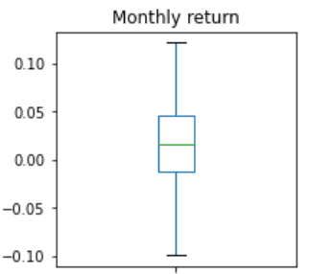
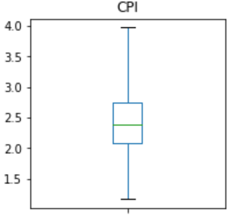
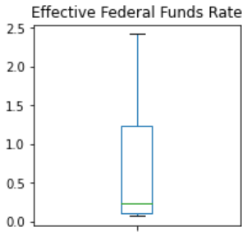
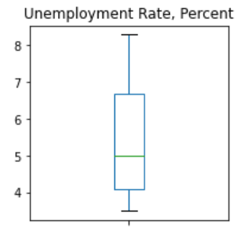
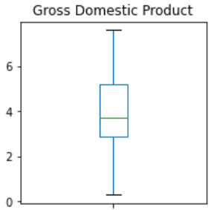
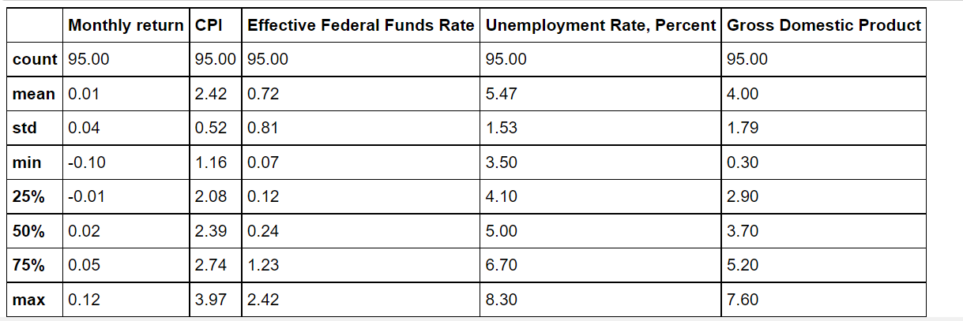
Dataset cleaning & Descriptive statistics
1. Convert Nadaq price into monthly return
2. The dataset has been analysed using mean, variance, max & min to check for outliers
Notes:
Our dataset has 95 points for around 10 years of monthly data. We took the data between Jan 2012 and end of 2019. When we look at the data and we can see on the box plot that we do not have outliers, we used the IQR * 1.5, the one by default, if we reduce a bit the whisk then we could argue there is some outliers for the CPI, others looks ok even if we can see a big skew for the fund rate, mainly because they where super low for a long time.

Slide 5
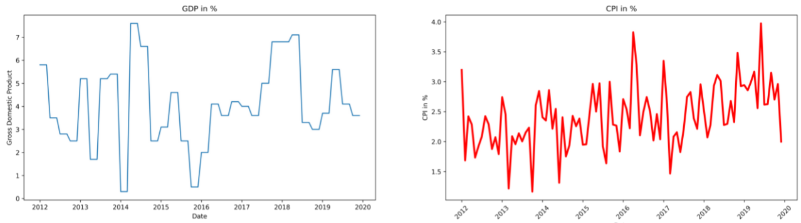
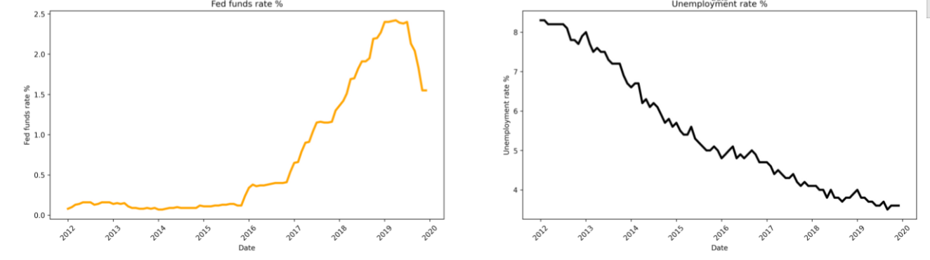
Independent variables - charts
Notes:
Here are our four independent variables we can seet the huge pic in GDP and uneployment due to the COVID crisis and here we can already see which one are going to be non stationary or not.

Slide 6
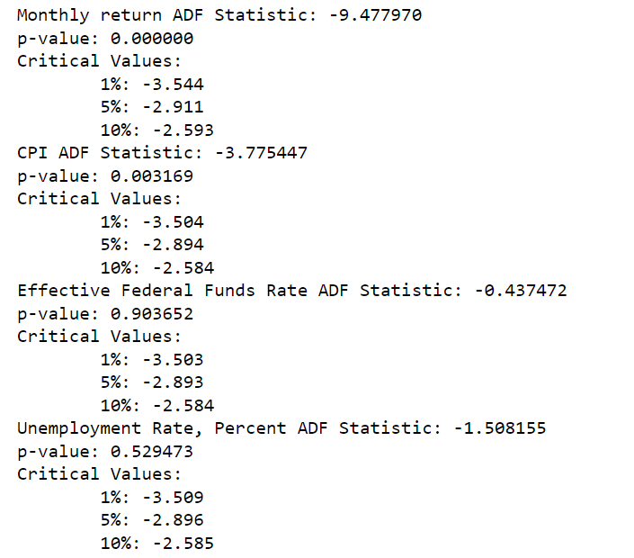
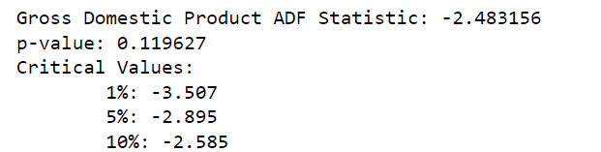
Test for stationarity
We tested for stationarity using the Augmented Dickey-Fuller test.
H0: p-value > 0.05: Fail to reject the null hypothesis, the data has a unit root and is non-stationary.
H1: p-value <= 0.05: Reject the null hypothesis , the data does not have a unit root and is stationary.
The results suggests we can that we can reject the null hypothesis for the Monthly return and CPI. Data are non-stationary for Fund rate, Unemployment and GDP
We used first-difference to make the series stationary
Notes:
When dealing with time series data, it is important to examine the existence of unit root in the data series. it is important to keep in mind that time series data analysis is subject to the problem of spurious regression if the data is non-stationary, resulting in unreliable results of the models constructed. So to avoid spurious regression, the unit root test (Augmented Dickey –Fuller test) will be conducted first to check if the time series data is stationary. Our hypothesis H0 is that the data has a unit root and is non stastionary and the H1 is that the data does not have a unit root and is stationary. Here we can see on the 5 variables. The monthly return and CPI are stationary, p-value is super small while the fund rate, unemployment rate and GDP are non-stationary. One method to make these variables stationary is to do a first difference so take the changes from one period to the next. Such a series is said to be difference-stationary

Slide 7
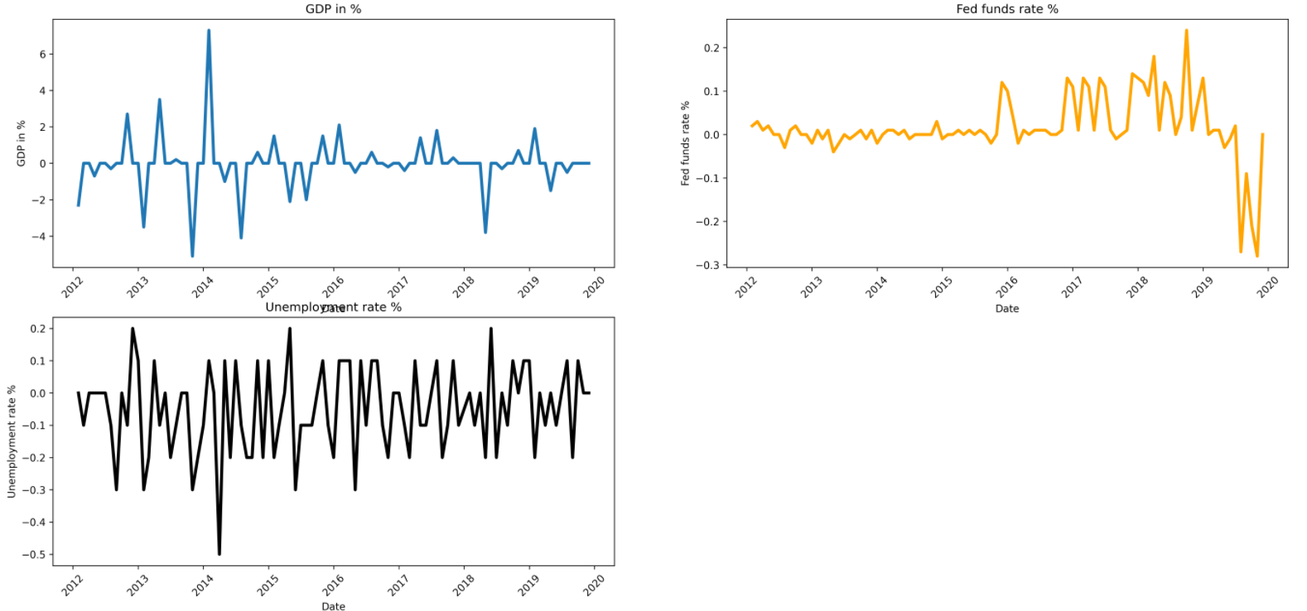
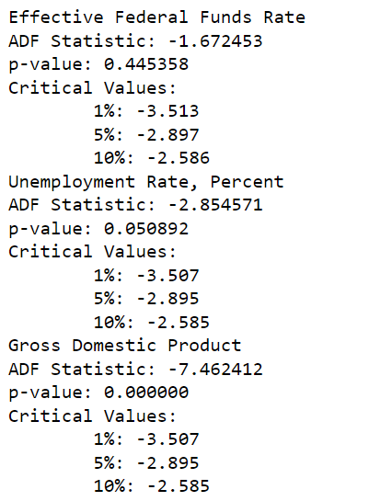
Test for stationarity – first difference
The results suggests we can that we can reject the null hypothesis for the GDP. Unit root is still present for Fund rate, Unemployment
We used second -difference to make the series stationary
Notes:
On the chart you can see the result and we can guess based on the charts that it looks a bit better and it looks a bit more like the CPI. Well now we do the same test with the same hypothesis and here there is still non stationarity for Unemployment rate and fed fund rate but we are getting there

Slide 8
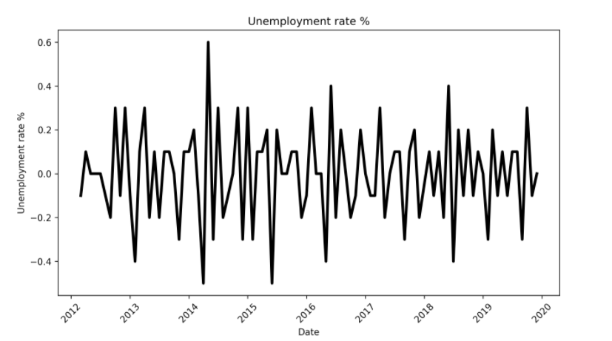
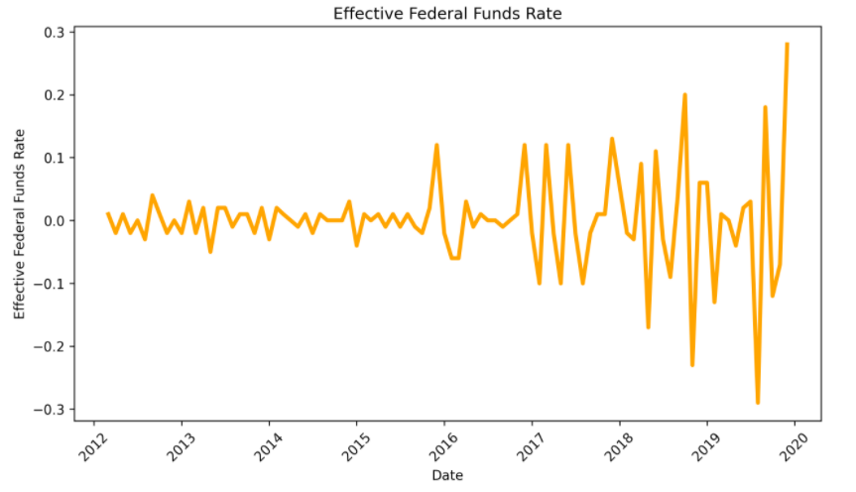
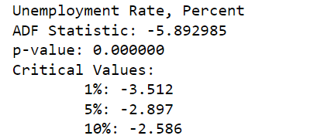
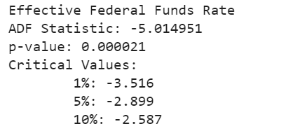
Test for stationarity – Second difference
The results suggests we can that we can reject the null hypothesis for the Unemployment and fund rate.
We can apply the OLS and Granger causality test
Notes:
The second difference shows the-pavlue is super small so it looks there is no unit-root anymore and should be abale to apply the OLS & Granger causality test

Slide 9
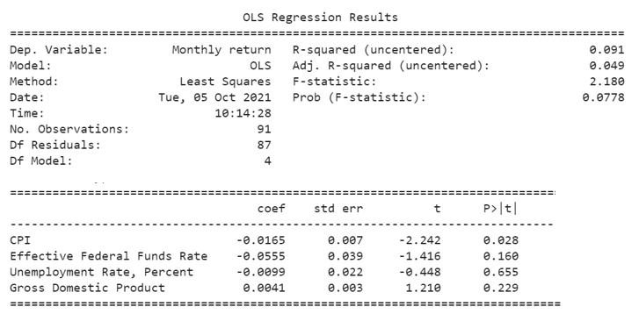
OLS regression results
-To analyze the relationship between the variables and the Nasdaq we run an OLS Regression.
-Despite being small the sign coeffs look as we would expect.
-The output shows a significant relationship between CPI and stock price.
. -Although the other macroeconomic variables are not significant, their coefficient signs confirm our expectations.
Notes:
The OLS presents the output of the Ordinary Least Square (OLS) method to show the impact of the macroeconomics variables on stock market prices. The output shows a significant relationship between inflation and stock price index (since its p-value 0.028 is less than 5%). The negative sign of the coefficients means that increase in inflation will cause stock price to fall. This is consistent with the previous evidence of a negative and significant linkage between inflation and stock returns (Lintner, 1973; Fama and Schwert, 1977). The other indicators does not show any significance the P value is higher than 5%, we have 0,16 for fund rate, 0,655 for unemployment rate and 0,229 for GDP but the sign makes sense. F-statistic is not significant, and our series is not that your regression model does fits the data better than the model with no independent variables.
The null hypothesis states that the model with no independent variables fits the data as well as your model.
The alternative hypothesis says that your model fits the data better than the intercept-only model.
Conclusion the CPI is the only variable that explain move in monthly return, and we should push further the analysis by using log, lag, ect our excepted / unexpected variables

Slide 10
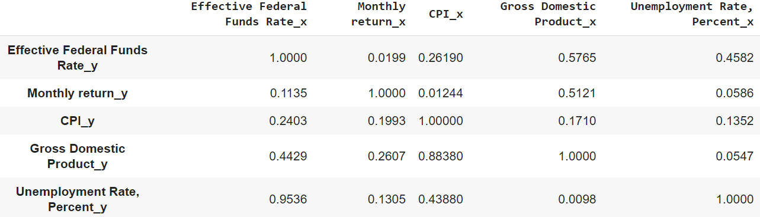
Granger causality test
P-value
Notes:
The row are the response (y) and the columns are the predictors (x). If a given p-value is < significance level (0.05), for example, take the value 0.0 in (row 1, column 2), we can reject the null hypothesis and conclude that CPI_X causes Monthly return_Y but not the other way around.

Slide 11
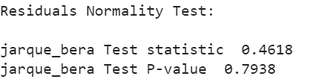
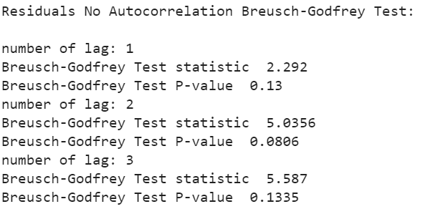
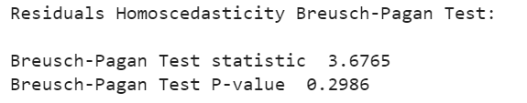
Appendix 1: Residual analysis
AUTOCORRELATION
The presence of serial correlation is examined by Breusch-Godfrey Test. Residuals for OLS output is tested for serial correlation, using the following hypothesis:
H0 : No autocorrelation
H1 : Autocorrelation
HETEROSCEDASTICITY
This test is important to confirm the robustness of the OLS output since we cannot rely on them in the presence of heteroscedasticity.
H0: No heteroscedasticity
H1: Heteroscedasticity
NORMALITY
this test is important to find out whether the error term follows normal distribution
H0: Residuals are normally distributed
H1: Residuals are not normally distributed
The p-value is 0.79 greater than the critical value at the 5% level. So, the null hypothesis cannot be rejected
The p-value is 0.3 which is greater than critical value at 5%. We cannot reject the null hypothesis and we can conclude that homoscedasticity is present, and thus OLS t-test results can be trusted.
The p-value is 0.13 which is greater than critical value at 5%. We cannot reject the null hypothesis and we can conclude for the absence of autocorrelation.
Notes:
To confirm and trust the T-test results from our OLS regression, we have to make sure that the residuals are white noise. Residuals from a regression should never contain any systematic information, since this is a sign that this information is not included in the regression model.

